Slide 1
Linear algebra
The best of the algebras

Slide 2
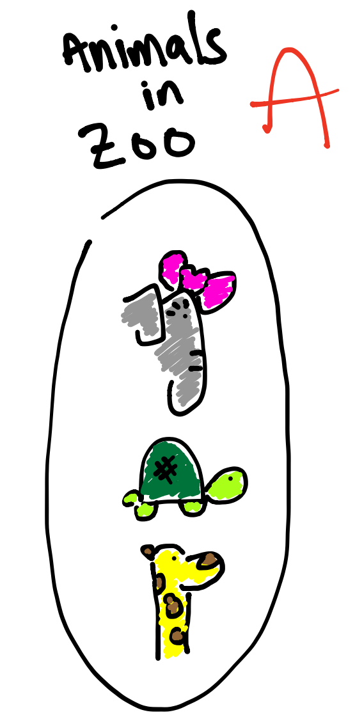
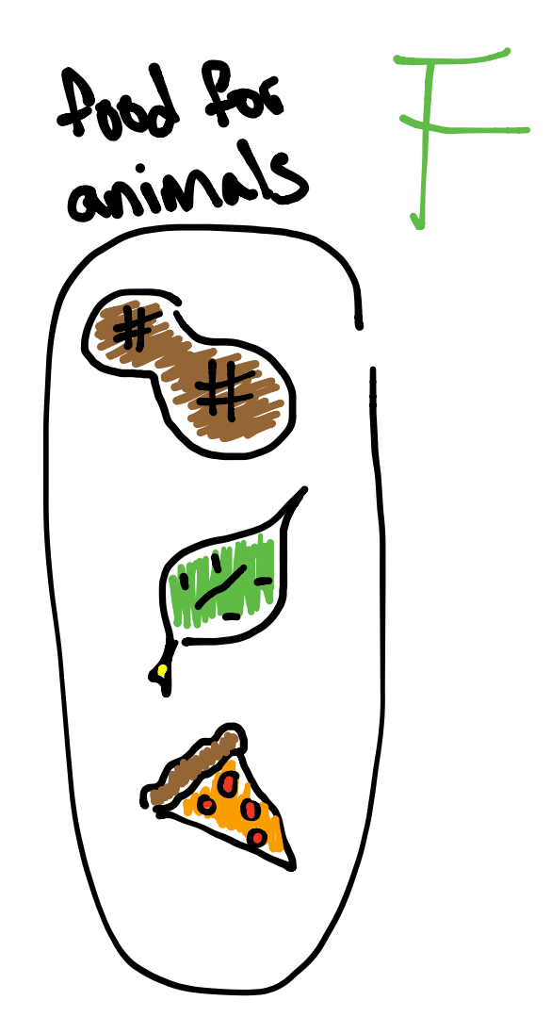
Functions as Sets

Slide 3
Functions as Sets
In words:
x
y
Is Related to
Whenever
x eats y

Slide 4
Functions as Sets
Is Related to
Is Related to
Is Related to

Slide 5
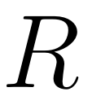
Functions as Sets
You are more used to seeing it like this:
( )=
( )=
( )=

Slide 6
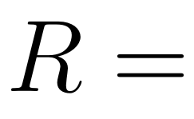
Functions as Sets
( , )
( , )
( , )

Slide 7
Functions as Sets
You may call this the “GRAPH”

Slide 8
(2-D)
y
x

Slide 9
Lines (2-D)
y
x

Slide 10
Come on Rob this stuff don’t describe no line!!!
Equation of a line:

Slide 11
Lines as relations
In words:
x
y
Is Related to
Whenever

Slide 12
Lines as relations

Slide 13
Lines (2-D)
y
x
One point of intersection

Slide 14
Lines as relations

Slide 15
Lines (2-D)
y
No intersection
x

Slide 16
Lines as relations

Slide 17
Lines (2-D)
y
x
Infinite intersection

Slide 18
Lines as relations

Slide 19
Lines as relations
How do we figure this out without a picture???

